Slide 1
Demo: Tempdb Resource Governance

Slide 2

Tempdb is growing out of control

Slide 3
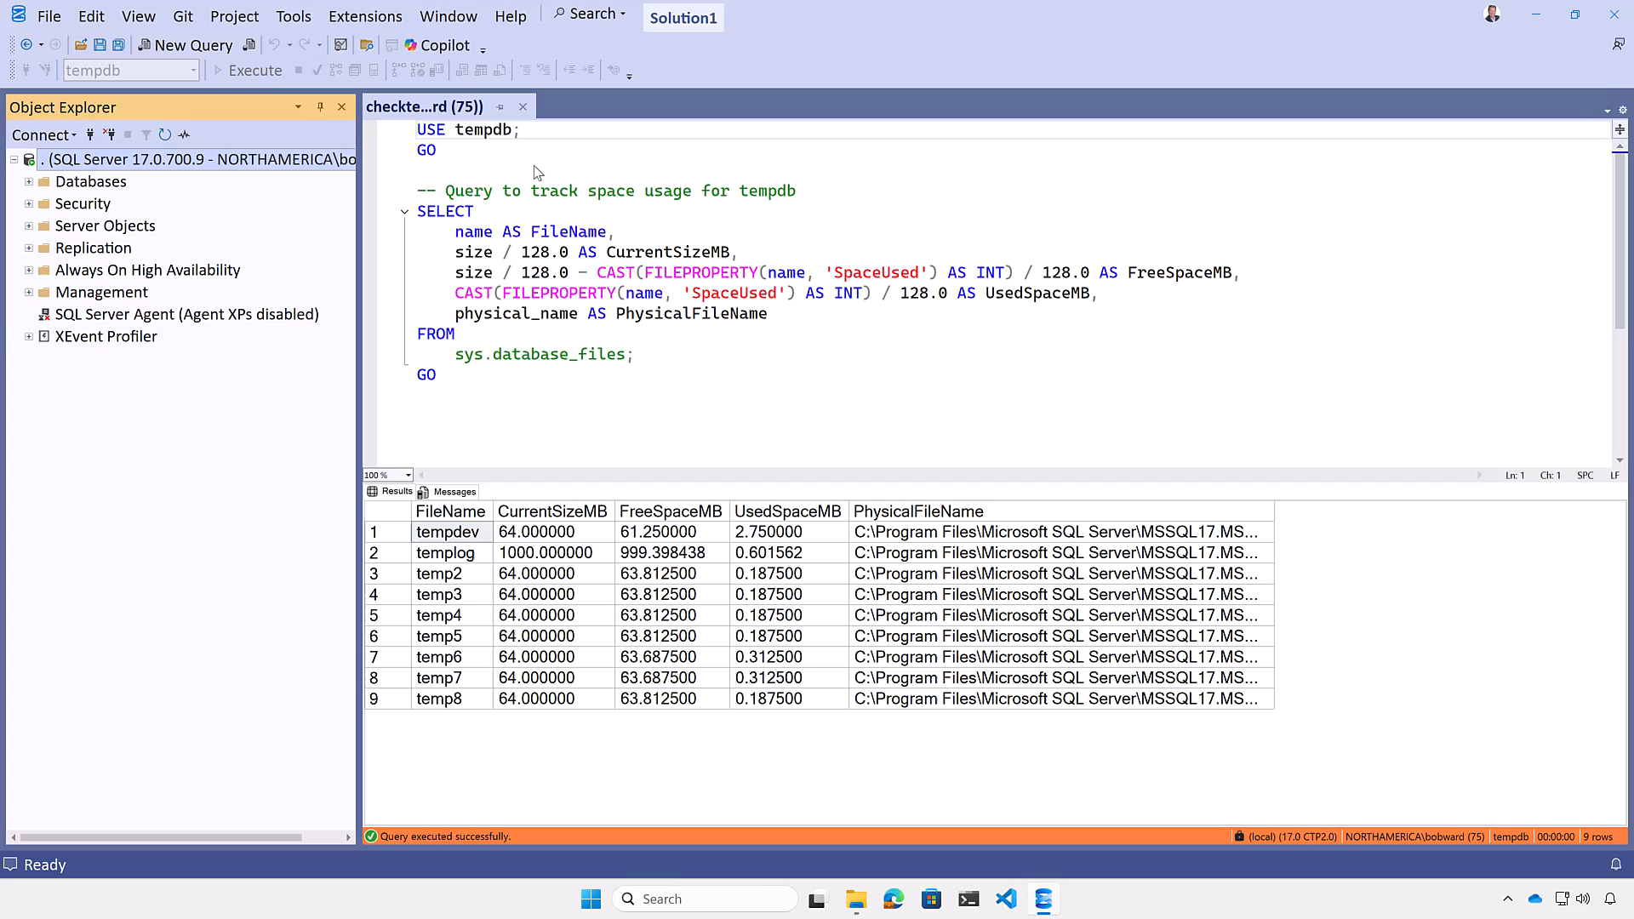

Slide 4
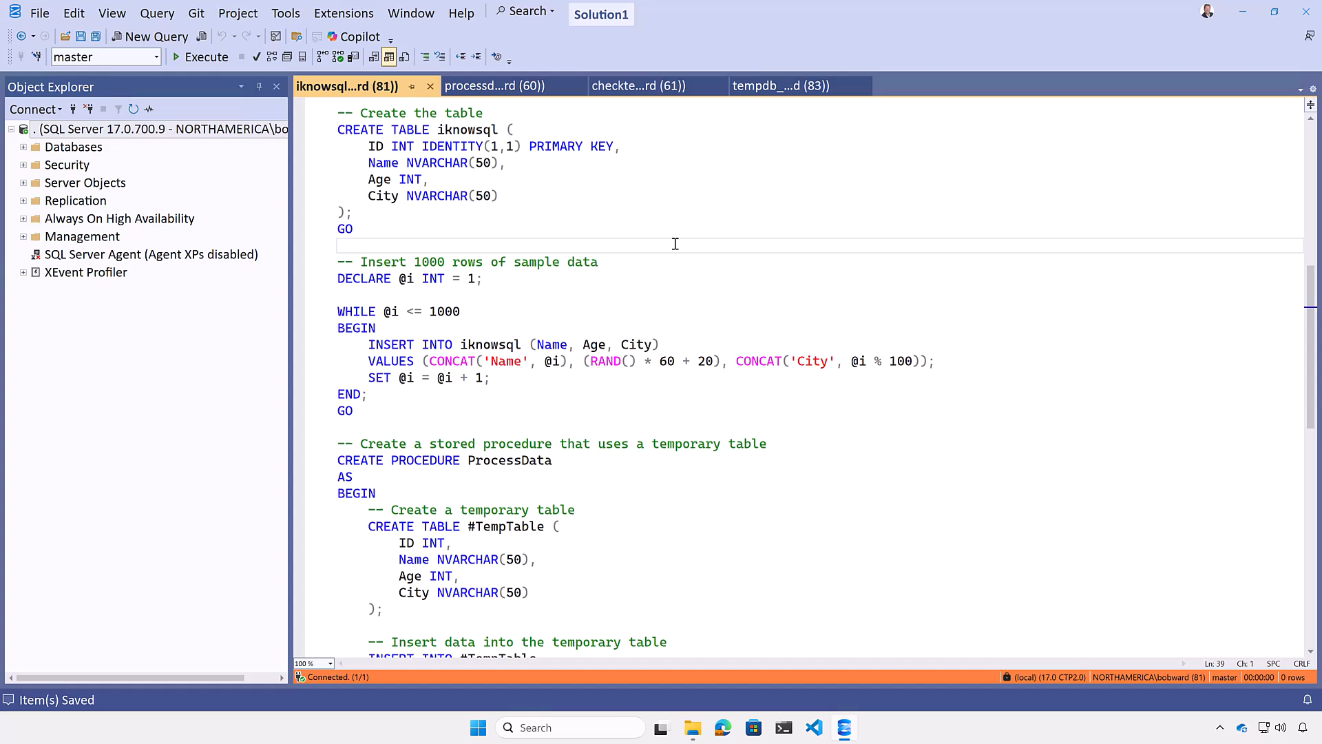

Slide 5
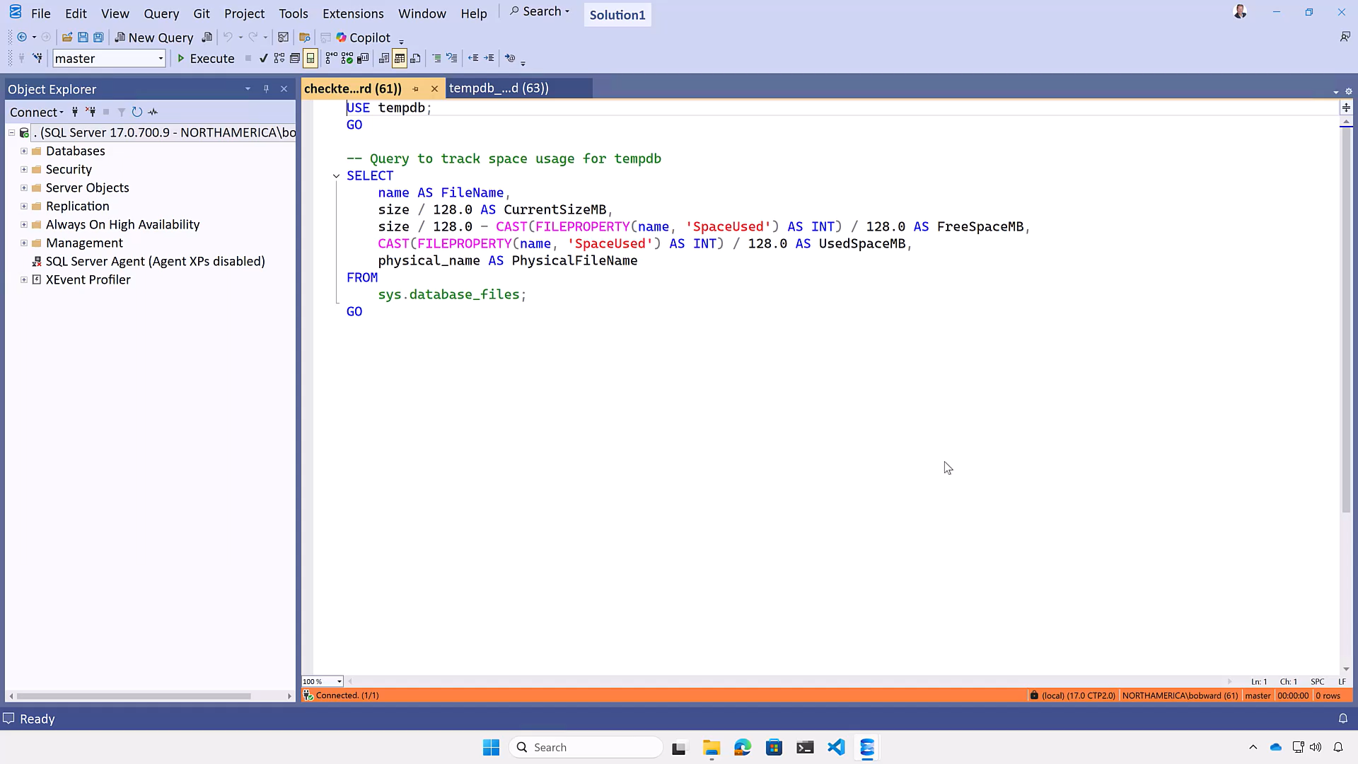

Slide 6
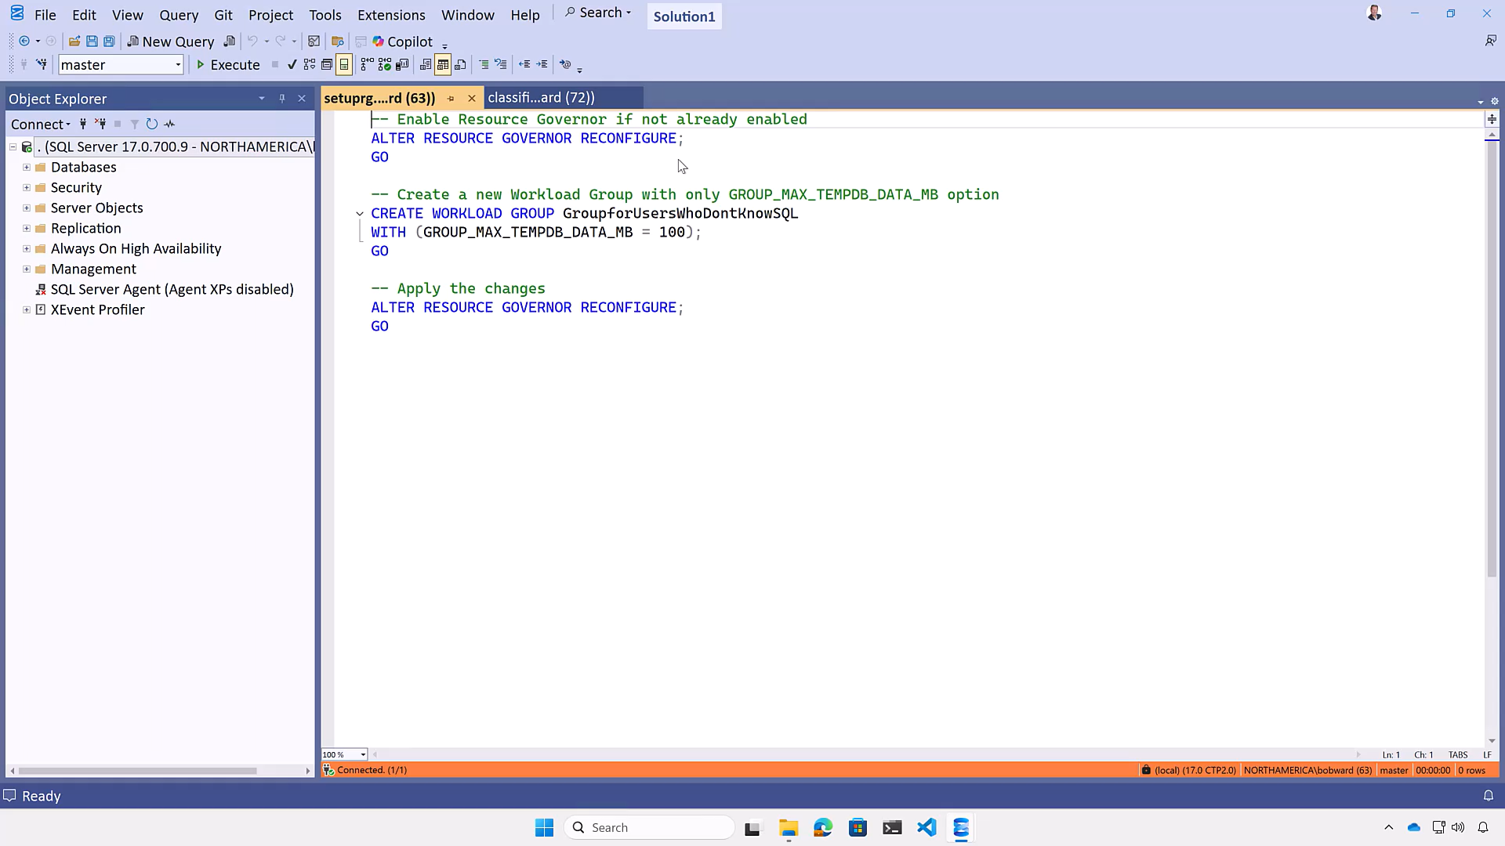

Slide 7
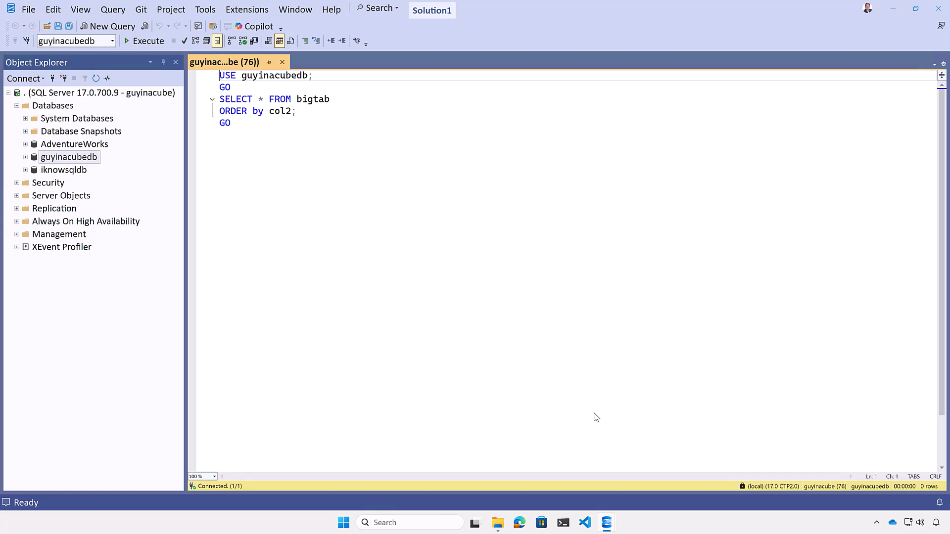

Slide 8
Accelerating performance for SQL Server
Optimized sp_executesql
Honor Compile locks and prevent plan cache bloat
Optional parameter plan optimization (OPPO)
Extend PSPO to handle NULLs
Accelerated Database Recovery (ADR) in tempdb
Get all the benefits of ADR for temp object transactions
Query store for readable secondaries
Empower performance analysis on all replicas
Persisted stats for readable secondaries
Predictable stats on all readable secondaries using query store channel

Slide 9



Query Store for read replicas
queries
DBM endpoint
Query Store stats
DBM
endpoint
Primary
replica
Read
replica
Query Store
stats
Query Store
stats
Query Store queries
Query Store queries

Slide 10

HADR

Slide 11
Enhancing the industry proven engine
Security
Security cache improvements
OAEP support for encryption
PBKDF password hashing
Authentication using system-assigned managed identity
Backup to URL with managed identity
Managed identity support for EKM
Managed identity for AI models
Entra logins with nonunique display names
Custom password policy on Linux
TDS 8.0/TLS 1.3 support for tools and features
Performance
Optimized Locking
Tempdb space resource governance
ADR in tempdb
Persisted stats for readable secondaries
Change tracking cleanup
Columnstore index maintenance
CE feedback for expressions
Optional parameter plans optimization
DOP feedback on by default
Query store for readable secondaries
ABORT_QUERY_EXECUTION query hint
Optimized sp_executesql
Batch mode optimizations
Remove In-Memory OLTP from a database
tmpfs support for tempdb in Linux
HADR
Fast failover for persistent AG Health
Async page request dispatching
Improved health diagnostics
Communication control flow tuning
Switching to resolving state
Remove listener IP address
NONE for routing
AG group commit waiting tuning
Contained AG support for DAG
DAG sync improvements
Backups on secondary replicas
ZSTD Backup compression
Backup to Azure immutable storage

Slide 12

Always On Availability Groups
Customer
driven
Failover & Monitoring
Tuning & Config
DAG
Fast failover
Reliable switch to Resolving State
Health check timeout diagnostics
Async page dispatching
Communication flow
Configure group commit
Contained AG support
Enhanced sync performance
Notes:
Failover and monitoring
Fast failover
Starting with SQL Server 2025 (17.x) Preview, you can set the RestartThreshold for an Always On availability group to 0, which tells the WSFC to fail over the availability group resource immediately when a persistent health issue is detected. This is useful for scenarios where you want to minimize downtime and ensure the availability group is always available on a healthy replica.
Reliable switch to resolving state
The update to the availability group recovery logic introduced in SQL Server 2025 (17.x) Preview enhances internal tolerance to this type of cluster quorum loss and prevents availability group databases from getting stuck in the Not Synchronizing state
Health check timeout diagnostics
Starting with SQL Server 2025 (17.x) Preview, the same performance monitor counters are now reported in the Windows Failover Cluster Log when a health check timeout is detected, similar to the lease timeout diagnostic output.
Tuning and Config
Async page dispatching
To improve undo-of-redo for this scenario, SQL Server 2025 (17.x) Preview introduces an update to the synchronization mechanism so that the availability group now performs page requests asynchronously, and in batches.
Communication flow
Use the max ucs send boxcars server configuration option to control the maximum number of UCS boxcars that can be used to send messages from the primary to the secondary replica. This option is useful for controlling the flow of data between replicas in an Always On availability group over a wide-area network (WAN).

Slide 13
Backups with SQL Server 2025
Backups for all types on secondary replicas
ZSTD Backup compression
Backup to Azure immutable storage
up to 30–50% better compression than MS_EXPRESS*
* Your mileage may vary
Notes:
Full backups on secondary replica – FULL and DIFF backups now supported in addition to COPY_ONLY and LOG backups
Backup to Azure immutable storage – Change to single commit to support Azure immutable storage (WORM drive)

Slide 14

Security

Slide 15
Enhancing the industry proven engine
Security
Security cache improvements
OAEP support for encryption
PBKDF password hashing
Authentication using system-assigned managed identity
Backup to URL with managed identity
Managed identity support for EKM
Managed identity for AI models
Entra logins with nonunique display names
Custom password policy on Linux
TDS 8.0/TLS 1.3 support for tools
Performance
Optimized Locking
Tempdb space resource governance
ADR in tempdb
Persisted stats for readable secondaries
Change tracking cleanup
Columnstore index maintenance
CE feedback for expressions
Optional parameter plans optimization
DOP feedback on by default
Query store for readable secondaries
ABORT_QUERY_EXECUTION query hint
Optimized sp_executesql
Batch mode optimizations
Remove In-Memory OLTP from a database
tmpfs support for tempdb in Linux
HADR
Fast failover for persistent AG Health
Async page request dispatching
Improved health diagnostics
Communication control flow tuning
Switching to resolving state
Remove listener IP address
NONE for routing
AG group commit waiting tuning
Contained AG support for DAG
DAG sync improvements
Backups on secondary replicas
ZSTD Backup compression
Backup to Azure immutable storage

Slide 16




Secure by default Provide the latest security capabilities for your data
Protected by
Microsoft Defender
outbound
inbound
Managed Identity
Enabled by
Azure Arc

Slide 17




Go passwordless with a Managed Identity
Microsoft Entra
Azure AI
Foundry Model
System Assigned
Managed Identity
API Key
NEW Azure Portal support
“12345abcde67890xyz12345abcde67890”
Azure Arc
DATABASE
SCOPED
CREDENTIAL
EXTERNAL MODEL or
sp_invoke_external_rest_endpoint

Slide 18
Securing SQL Server 2025
Security cache improvements
Reduce cache invalidation to speed up non-cache permission checks
TDS 8.0/TLS 1.3 support for tools and features
Ensuring our tools and features use TDS 8.0/TLS 1.3
Optimal Asymmetric Encryption Padding (OAEP) support for encryption
Uses a combination of a hash function and a mask generation function to create a more secure padding
PBKDF password hashing
Enhanced password hashing to meet NIST guidelines

Slide 19

Some T-SQL Love
RegEx functions
BASE64 functions
PRODUCT()
Fuzzy string match
functions
CURRENT_DATE returns DATE
SUBSTRING()
optional length
|| string concat operator
DATEADD() supports bigint
UNISTR()

